Slide 1



DR University
Land Deals!
December 2025
Presented by Alan Zholdubaev

Slide 2
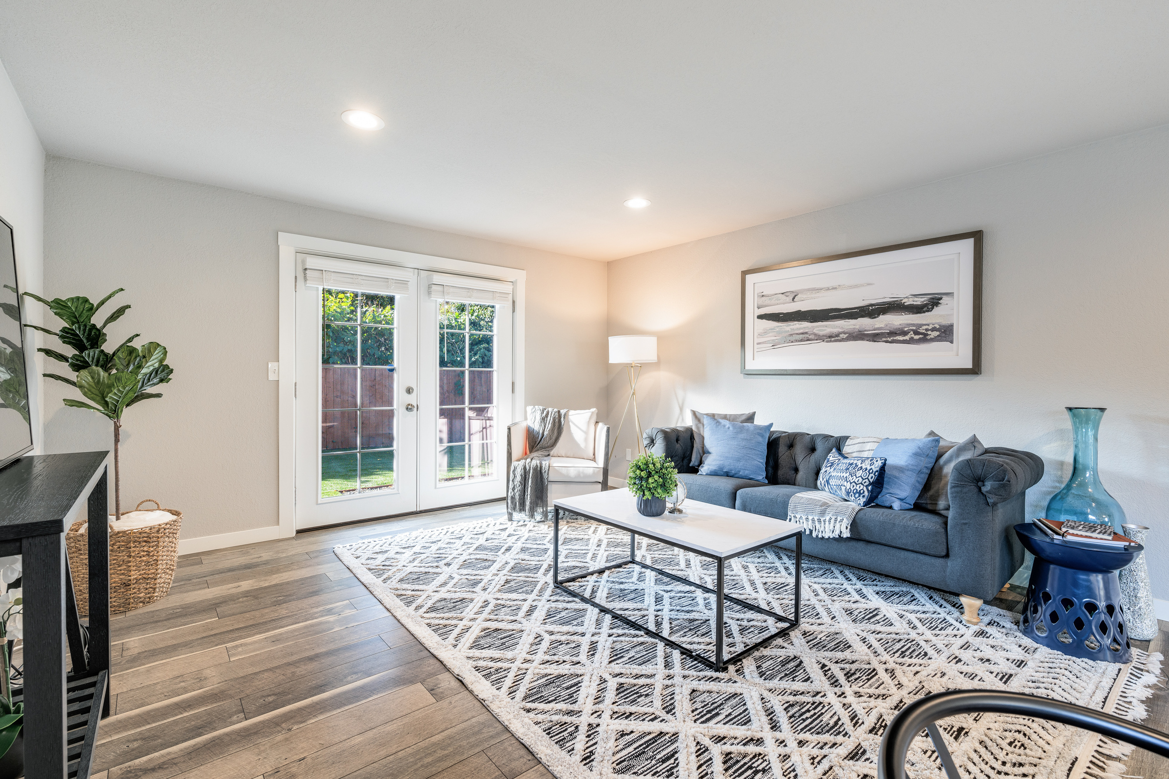
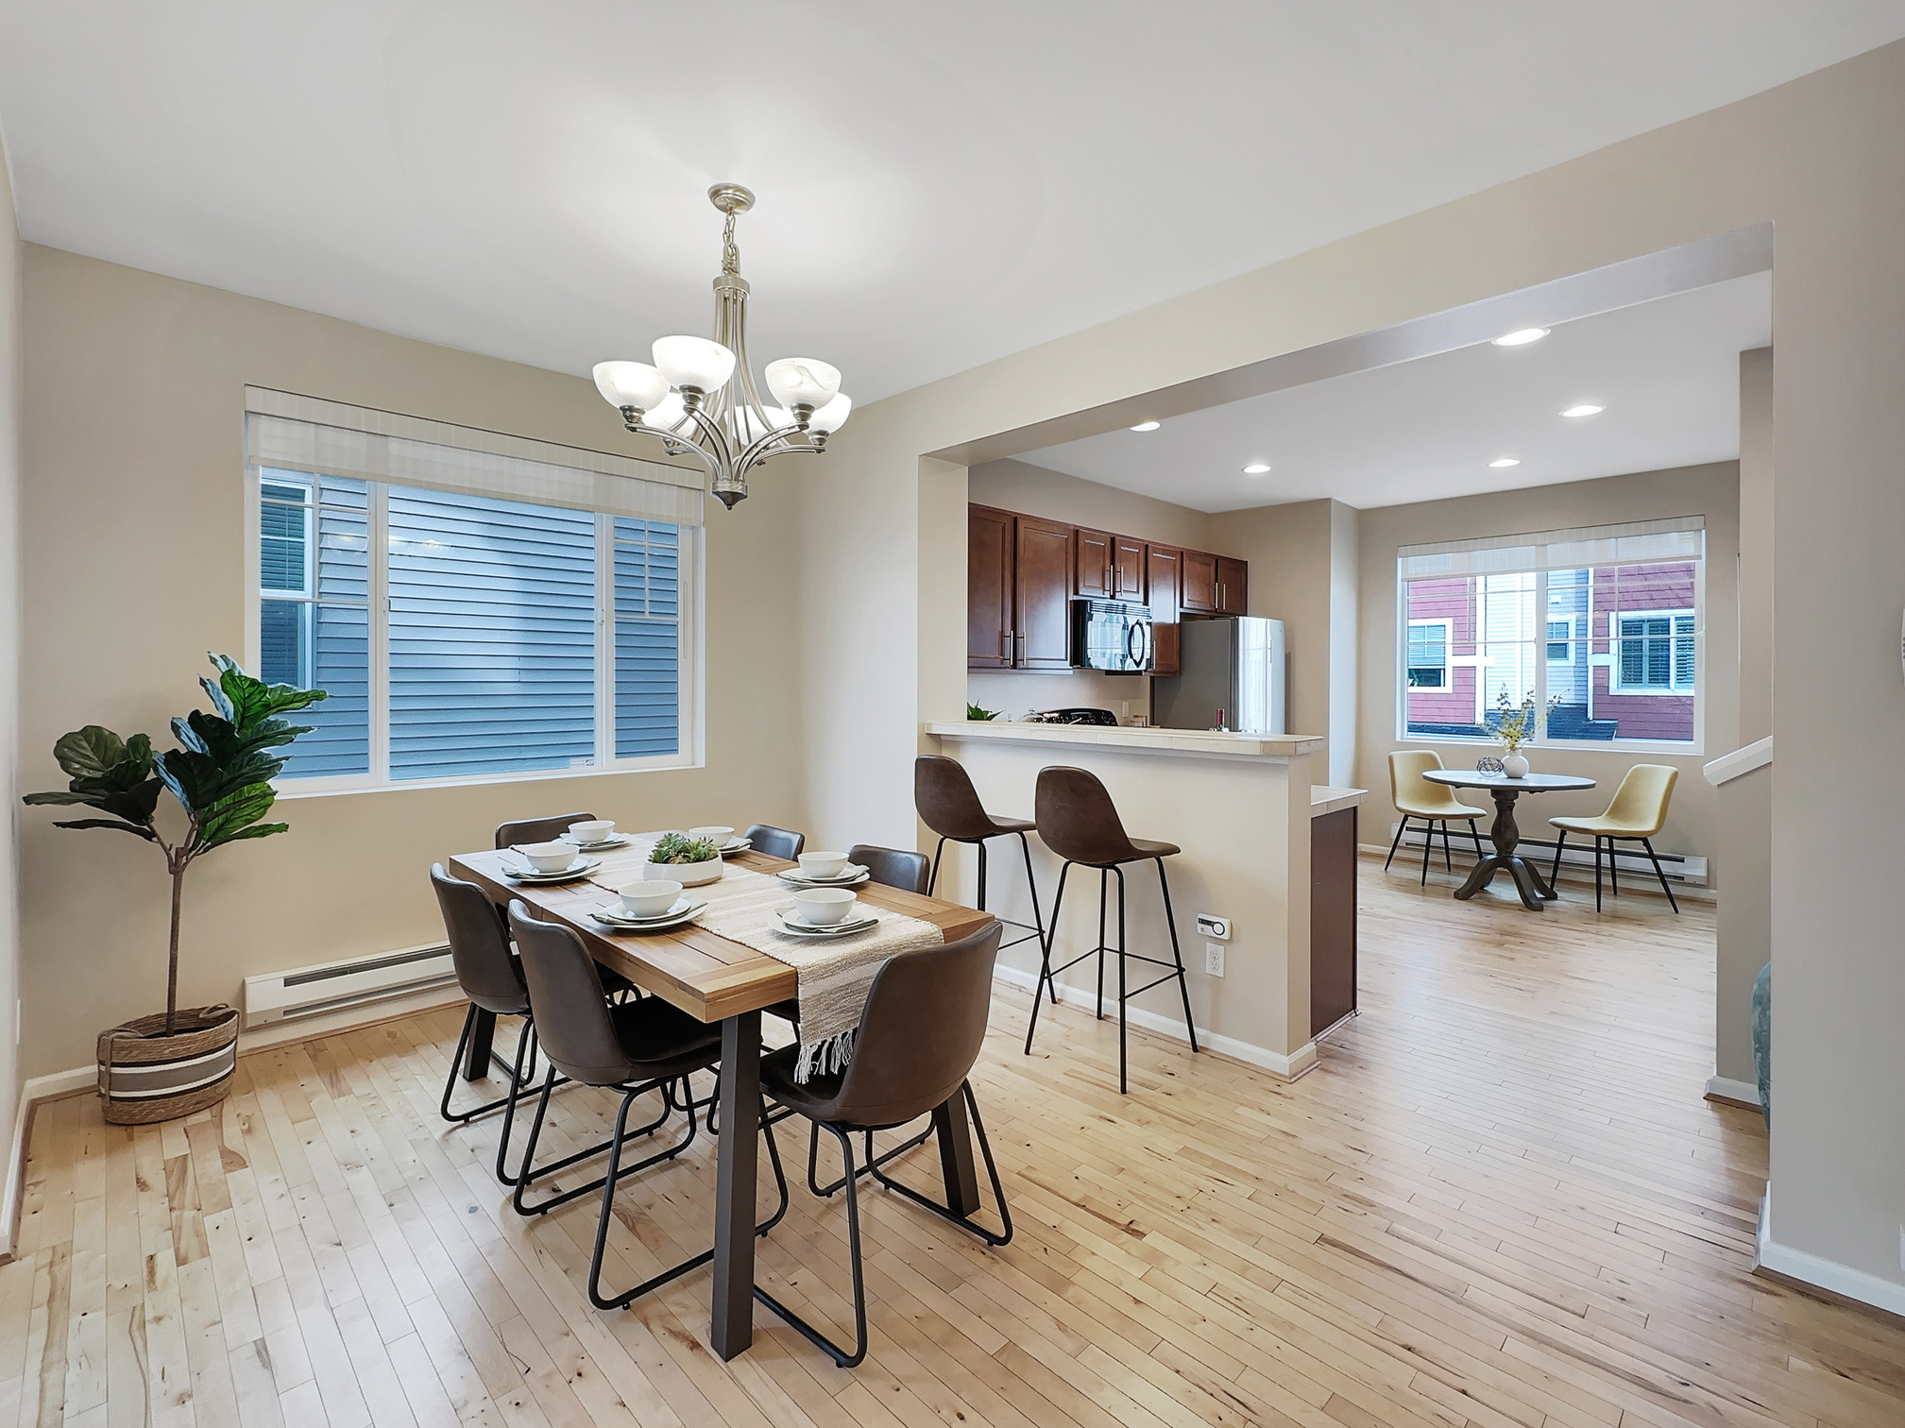


Agenda
Understand Land through the eyes of a buyer
How to research land
Zoning, Uses, Restrictions, Comping
Developers approach
Feasibility
Land ALM
Form 41

Slide 3

Land through the eyes of a buyer
Objective: To understand what the buyer goes through so you can guide them
Step 1:
Find a land
Step 2:
Get financing
Not easy to get financed, major banks or specific land lenders

Slide 4
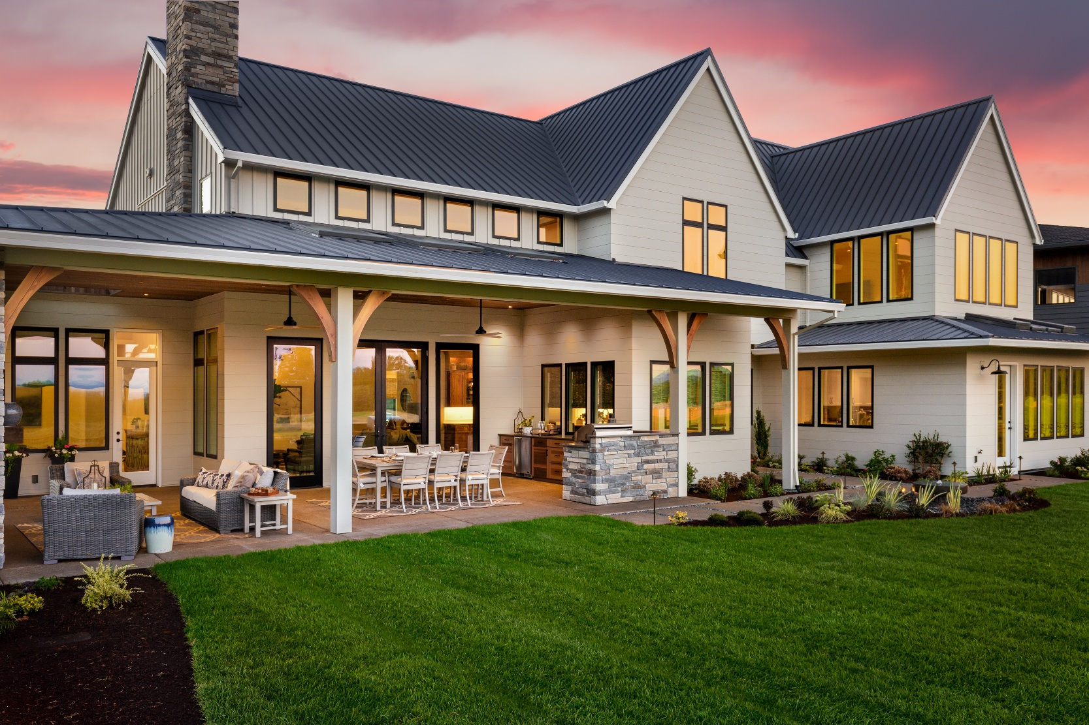
Research
Zoning/Jurisdiction
Your foundation for understanding what you can build and who to chat with: city or the county
Allowed Uses
Identify which types of development are permitted based on your goals.
Restrictions
Recognize the obstacles, limitations, and requirements you’ll need to navigate or work around.
Highest and Best Use
Determine the most profitable and efficient way to maximize the land’s potential.
Land Valuation (Comping)
Analyze comparable sales to accurately estimate the property’s market value.
Developer’s Mindset
Think like a builder—evaluate feasibility, costs, risks, and returns to operate at a professional level.

Slide 5

Buying the Land
Offer Writing
Often the easiest part of a land transaction—once you understand the forms and your strategy.
Form 25 (Purchase & Sale Agreement): The core contract that outlines price, terms, timelines, and responsibilities.
Form 22D (Optional Clauses): Adds important protections and custom conditions specific to land deals.
Form 35F (Feasibility Contingency): Your buyer’s safety net. It allows time to investigate whether the land is buildable and profitable before fully committing.
Legal Description:
Is the official, precise, and legally recognized way to identify a parcel of real property in Washington State.

Slide 6
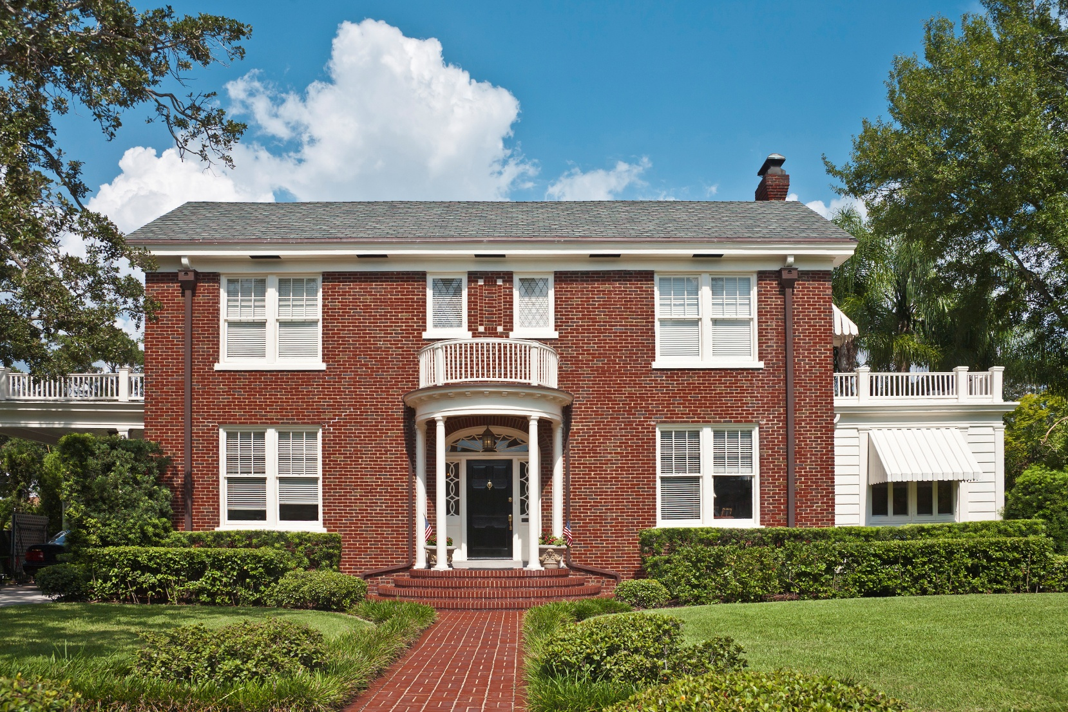
Feasibility
Feasibility Study
Think of this as a home inspection for land—but far more detailed and essential. This period determines whether your project can actually be built and whether it will make financial sense.
Key components include:
Surveying
Determines boundaries, easements, topography, slopes, and any encroachments. Critical for design, setbacks, and understanding buildable area.
Environmental & Site Professionals
Geotechnical Engineers: Analyze soil stability, slopes, and landslide risk.
Wetland Specialists: Identify critical areas and buffer requirements.
Arborists / Tree Cutters: Evaluate tree health, removal limits, and city requirements.
Utility Assessments
Verify availability, cost, and connection feasibility for:
Septic Systems: Perc tests, drain field approvals, replacement areas.
Wells: Water availability, purity, and drilling requirements.
Electricity: Access, transformer requirements, and distance to nearest pole.
Natural Gas: Availability or propane alternatives.
Garbage & Services: Ensure access, fire flow standards, and emergency vehicle access.
Design & Construction Specialists
These partners help determine what can be built, how much it will cost, and whether the project is financially viable.
Architects: Create site plans, floor plans, and initial concept designs based on zoning and site limitations.
Builders/Contractors: Provide cost estimates, feasibility input, and construction timelines.
Civil & Structural Engineers: Handle grading, drainage, stormwater, structural safety, and compliance with local building codes.

Slide 7

Permitting
Permitting is the formal approval process required by local governments before you can build, remodel, or develop housing. It ensures your project meets all legal, safety, environmental, and zoning requirements.
In Washington, permitting is often the longest and most time-consuming phase of a residential development project.
Typical Permitting Timelines in Washington
King County: One of the slowest jurisdictions. Full permitting can take around 12 months or longer, depending on complexity, critical areas, and workload.
Snohomish County: Generally faster than King. Most standard residential permits take approximately 8 months.
Pierce County: Often more efficient, with many permits completing in roughly 7 months.
City Jurisdictions: City planning departments (Bellevue, Everett, Puyallup, etc.) can be significantly faster because they typically have clearer zoning, shorter review cycles, and better staffing. Timelines vary, but city permits often move quicker than their county counterparts.

Slide 8
Closing
Closing on a Land Deal
Closing is the final step in a land purchase where ownership officially transfers from the seller to the buyer.
This happens after all feasibility work is completed and you’ve confirmed the land is suitable for your intended use.
In Simple Terms
Once you finish your feasibility studies, you either:
Proceed to closing, meaning you finalize the transaction, or
Exit the deal if feasibility reveals issues and your contingency allows you to back out.
Exception: Developer Terms
If the offer includes developer-friendly terms (extended feasibility, closing on permits), the timeline and requirements for closing may look different. In those cases, closing happens only after specific development steps or approvals are satisfied.

Slide 9

Building
You begin construction on the home, a process that typically takes around six months, depending on scope and conditions.

Slide 10
Land ALM
Many of our callers will be inquiring on land. But have no fear, we have a roadmap for that too!
Intro: "I see you are looking at this piece of land in ______. Do you want to go take a look, or do you have some specific questions for me?”
When the caller asks you a question, use your 4-point system when you don't have the answer, ending with a question from below. Continue asking questions until you feel you have enough information to start working with this caller.
Dive into the 5 W's:
Who: Have they built before or owned before?
What: What do they want to do with the property?
Where: Is this the only area?
When: When are they wanting to make a move?
Why: Why do they want to build or have a recreational property?

Slide 11
Land ALM – Continuation
Other questions:
How familiar are they with the area?
How far down the rabbit hole have they gone?
Are you cash or looking at financing?
Wrap Up:
Tour That Property (or others) or Meeting to review information needed
You now will give them 2 options for next steps. You can meet at the property or you can schedule a meeting (via zoom or in person) to review the information you need to go find.
Example: “Ok, so I'm going to gather up that information, and I want to take a peak at a couple other properties too. Do you want to get boots on the ground and meet out at this property and walk and talk? Or we can pop onto zoom and go over this stuff."

Slide 12
Things to bring to land appointment
1. Proper Footwear
Hiking boots or waterproof boots Land in WA is often muddy, uneven, or overgrown. Sneakers won’t cut it.
2. Weather-Ready Clothing
Rain jacket (Washington essential)
3. Navigation & Property Tools
Printed parcel map
GIS map screenshots (county, wetlands, slope, topo, zoning overlays)
Compass or GPS app

