Slide 1



DR University
WTF are Manufactured Homes
January 2026
Presented by Alan Zholdubaev

Slide 2
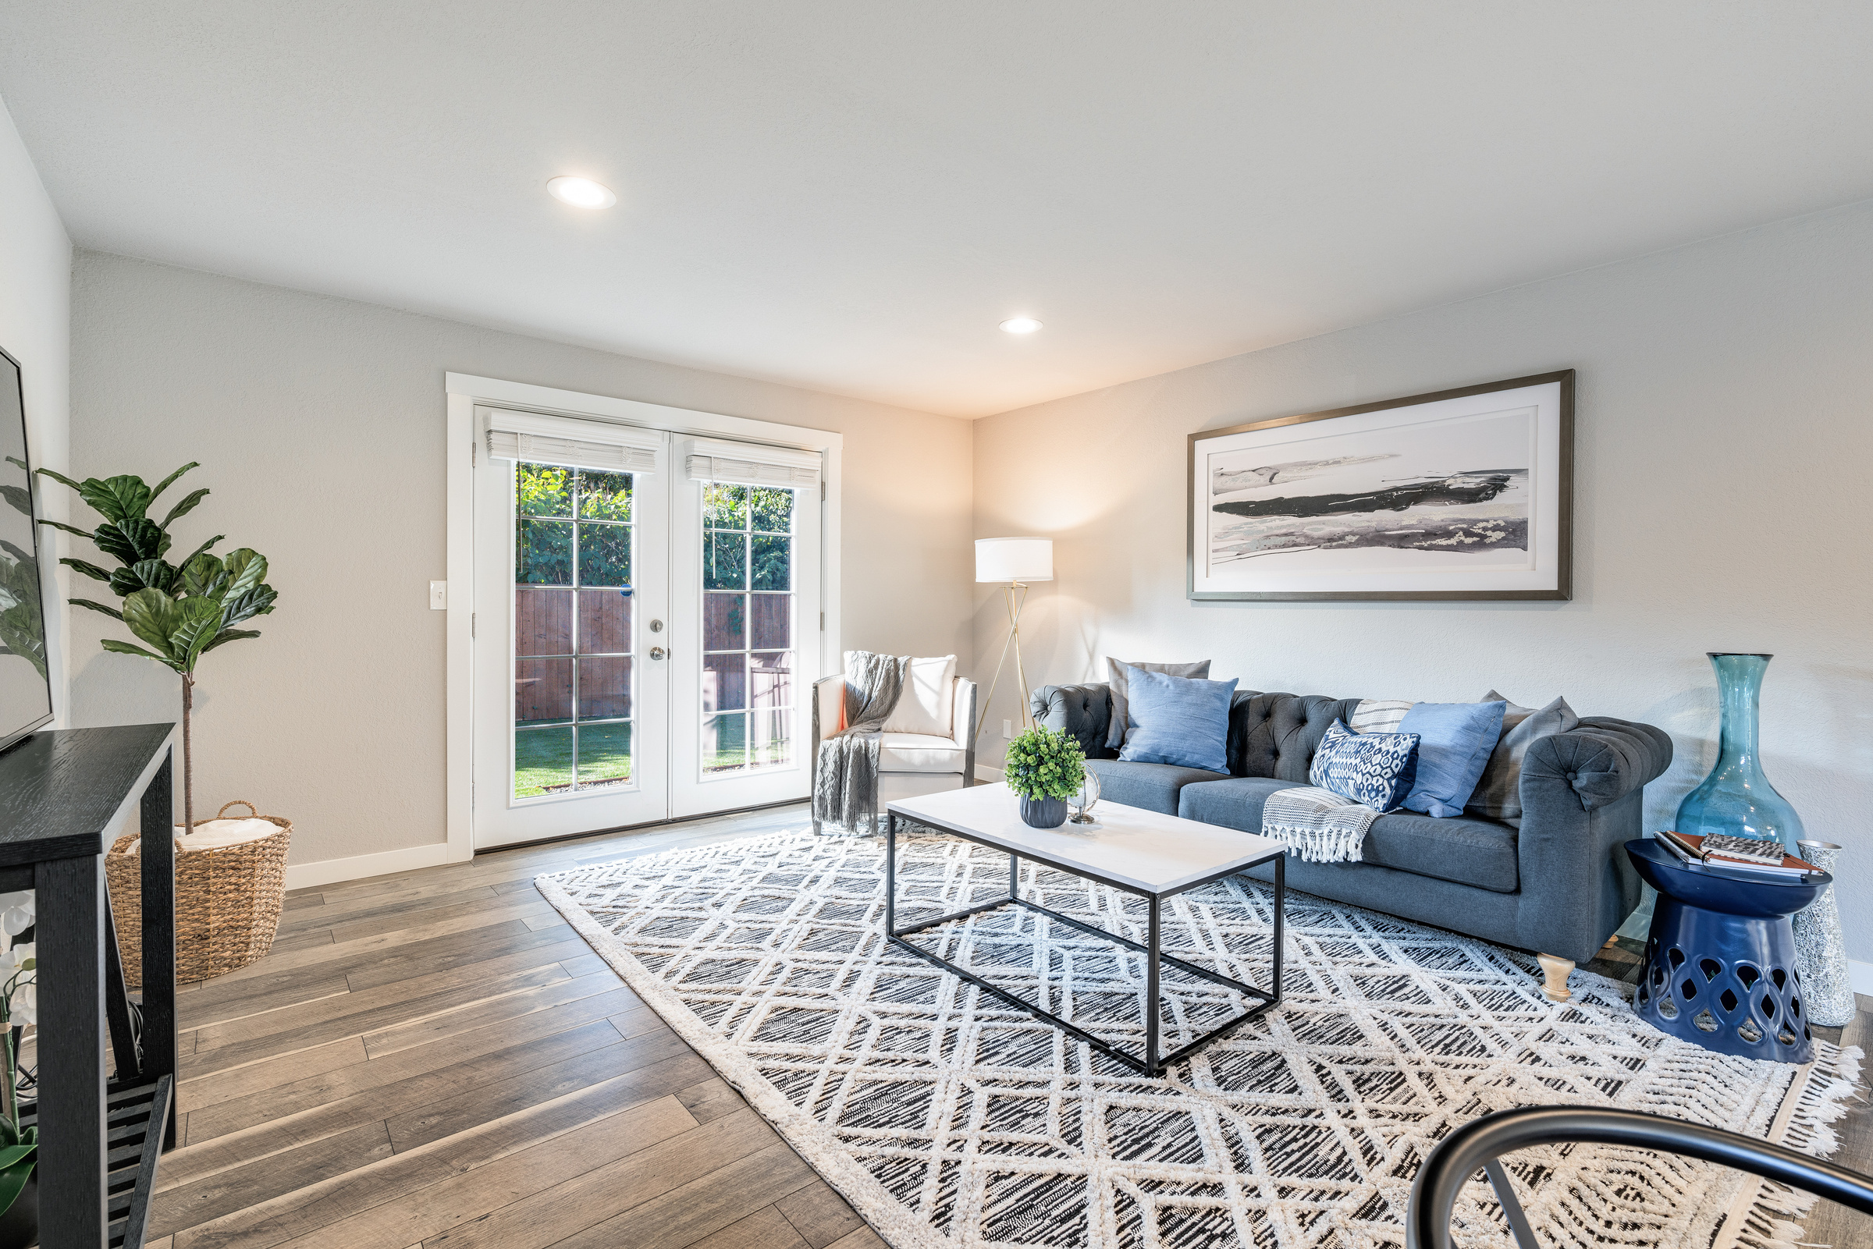
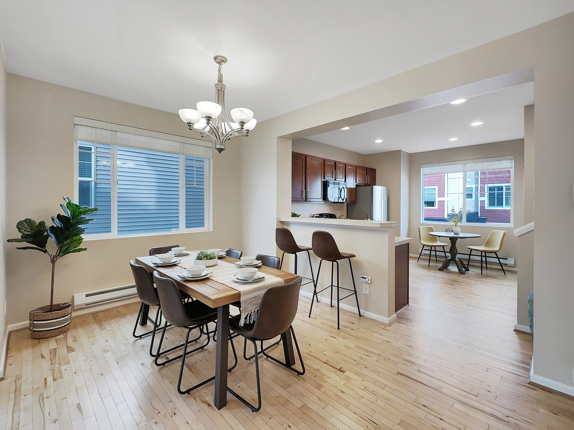


Topics:
What is a manufactured home?
Types of MH homes and how to distinguished them
MH condition and materials
Space rent vs Owned
Title elimination vs Not
Financing requirements
Comping

Slide 3
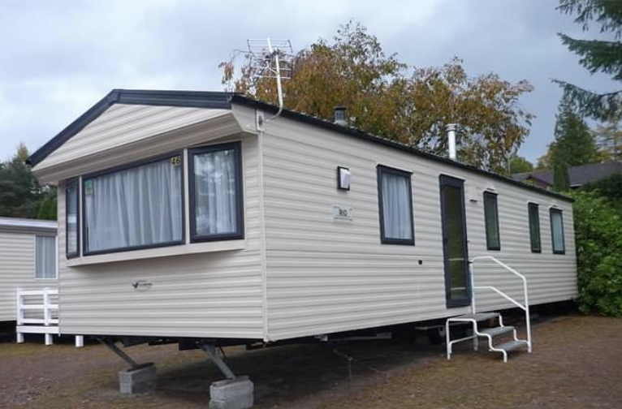
What is a Manufactured Home?
Manufactured vs Mobile vs Modular are all considered prefabricated (prefab) homes.
Sometimes referred to as trailers, MH are houses completely constructed in a factory and built on a fixed, steel chassis (rather than a permanent foundation).

Slide 4
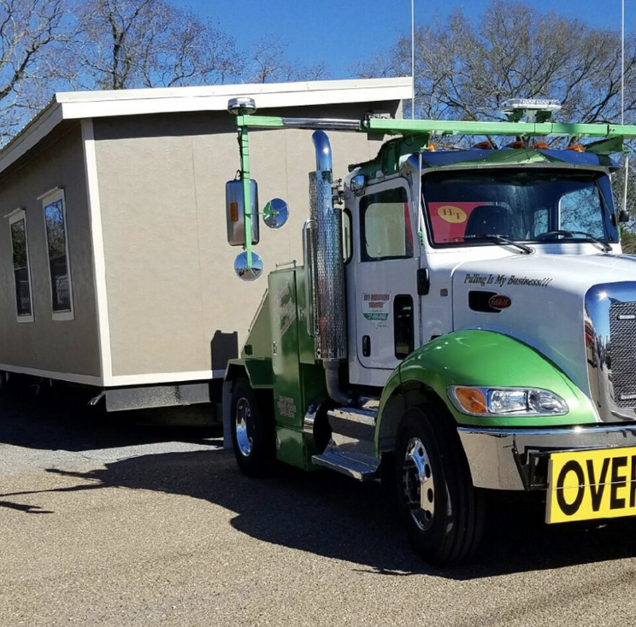
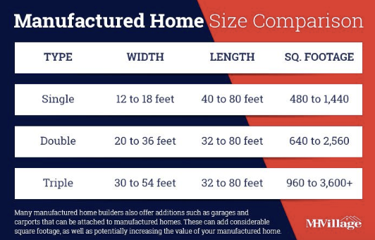
Transportation
Literally moved on a truck. Comes with wheels and gets taken off when being situated on-site
All MH are a uniform width

Slide 5
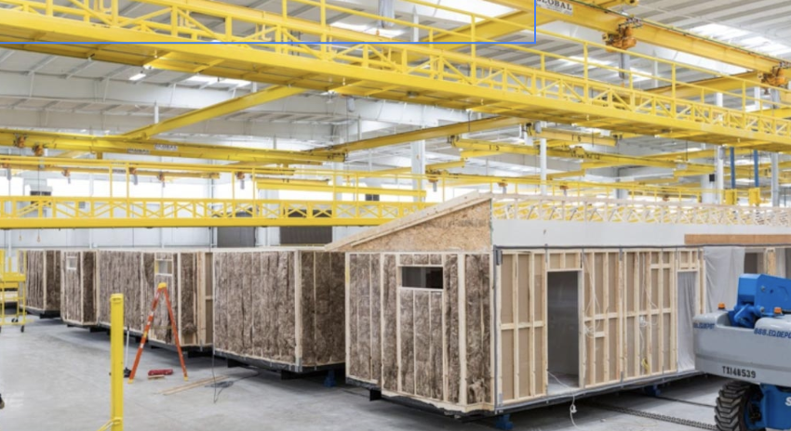
History
Mobile homes and MH used interchangeably, but difference was established in 1974 through National Mobile Home Construction and Safety Act followed by 1976 HUD Manufactured Home Construction and Safety Standards (usually called HUD code) which set federal standards in areas.
Prior to 1976, mobile homes were mass produced due to the demand for affordable, moveable housing, but there was very little oversight when it came to building specifications. Starting in the early 1900s, people found they needed to be able to move to wherever jobs were available in order to provide for their families, and so the mobile home was born.

Slide 6
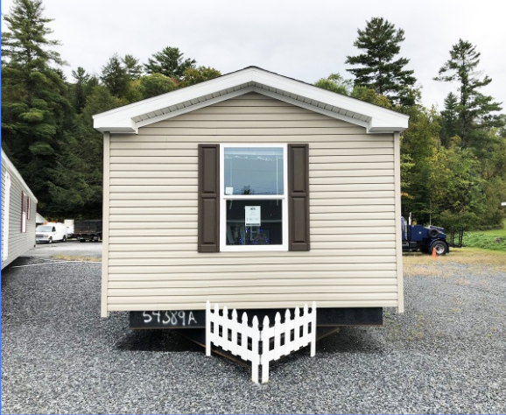
Types of MH
Single Wide

Slide 7
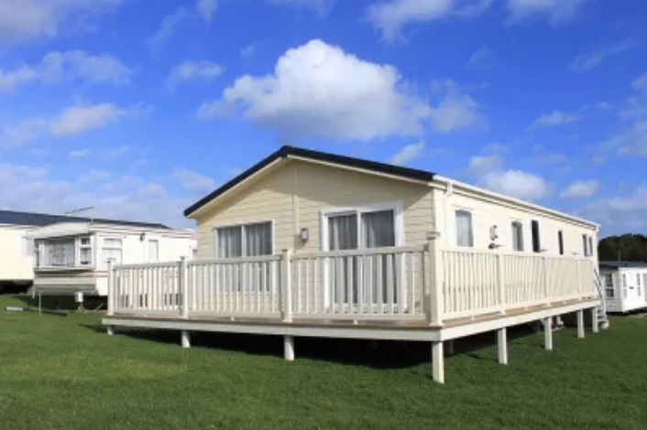
Types of MH
Double
Wide

Slide 8
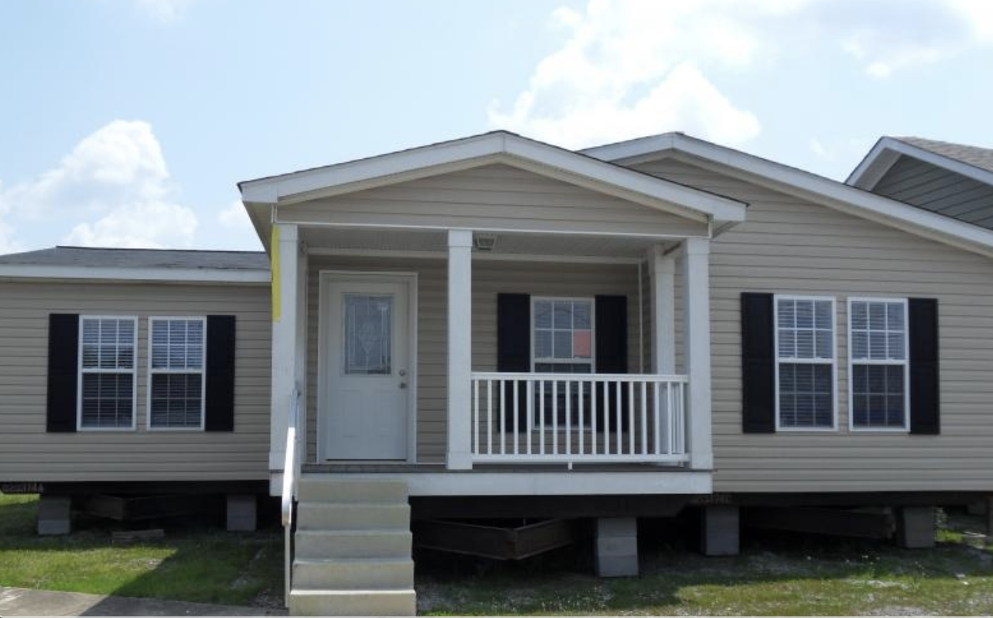
Types of MH
Triple
Wide

Slide 9
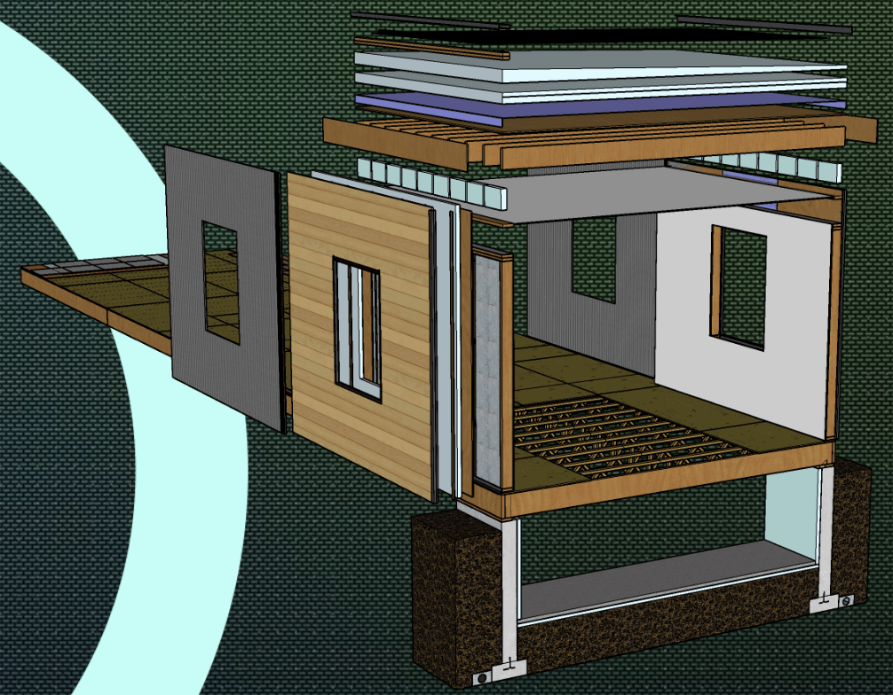
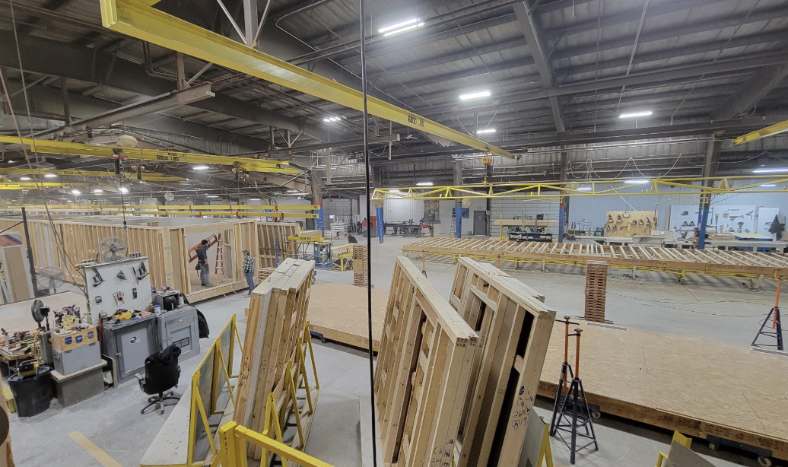
Types of MH
Modular

Slide 10
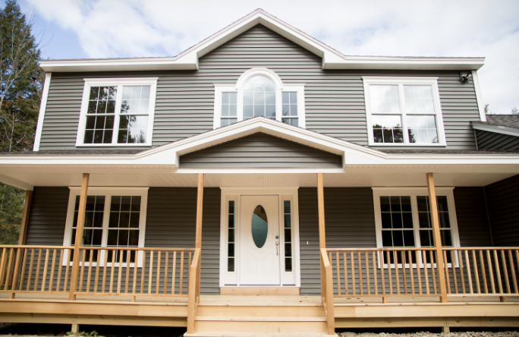
Modular Homes
Modular homes are appraised against stick built homes
Most modular homes look very good, like a normal rambler
Modular homes are held to State's code standards, while mobile homes are held to federal standards
Modular homes tend to have better appreciation because of it

Slide 11
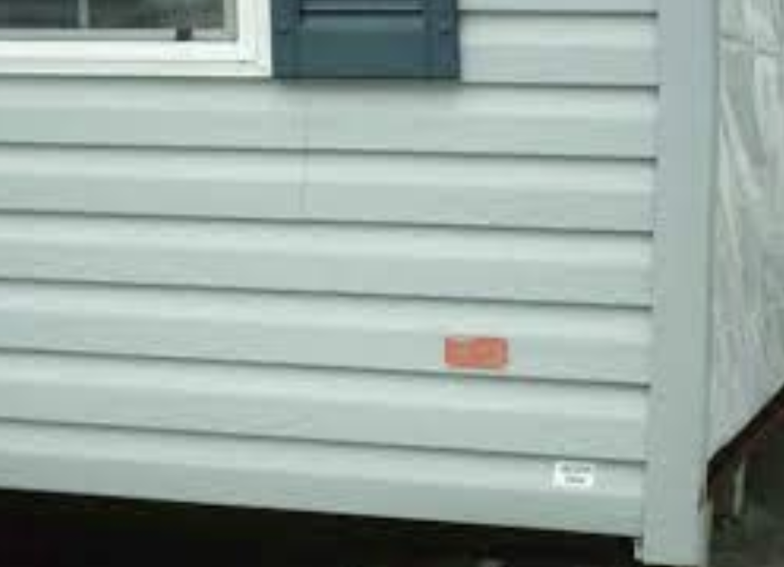
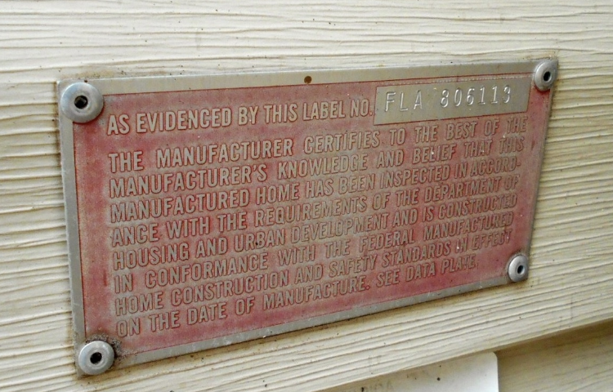
HUD tags

Slide 12
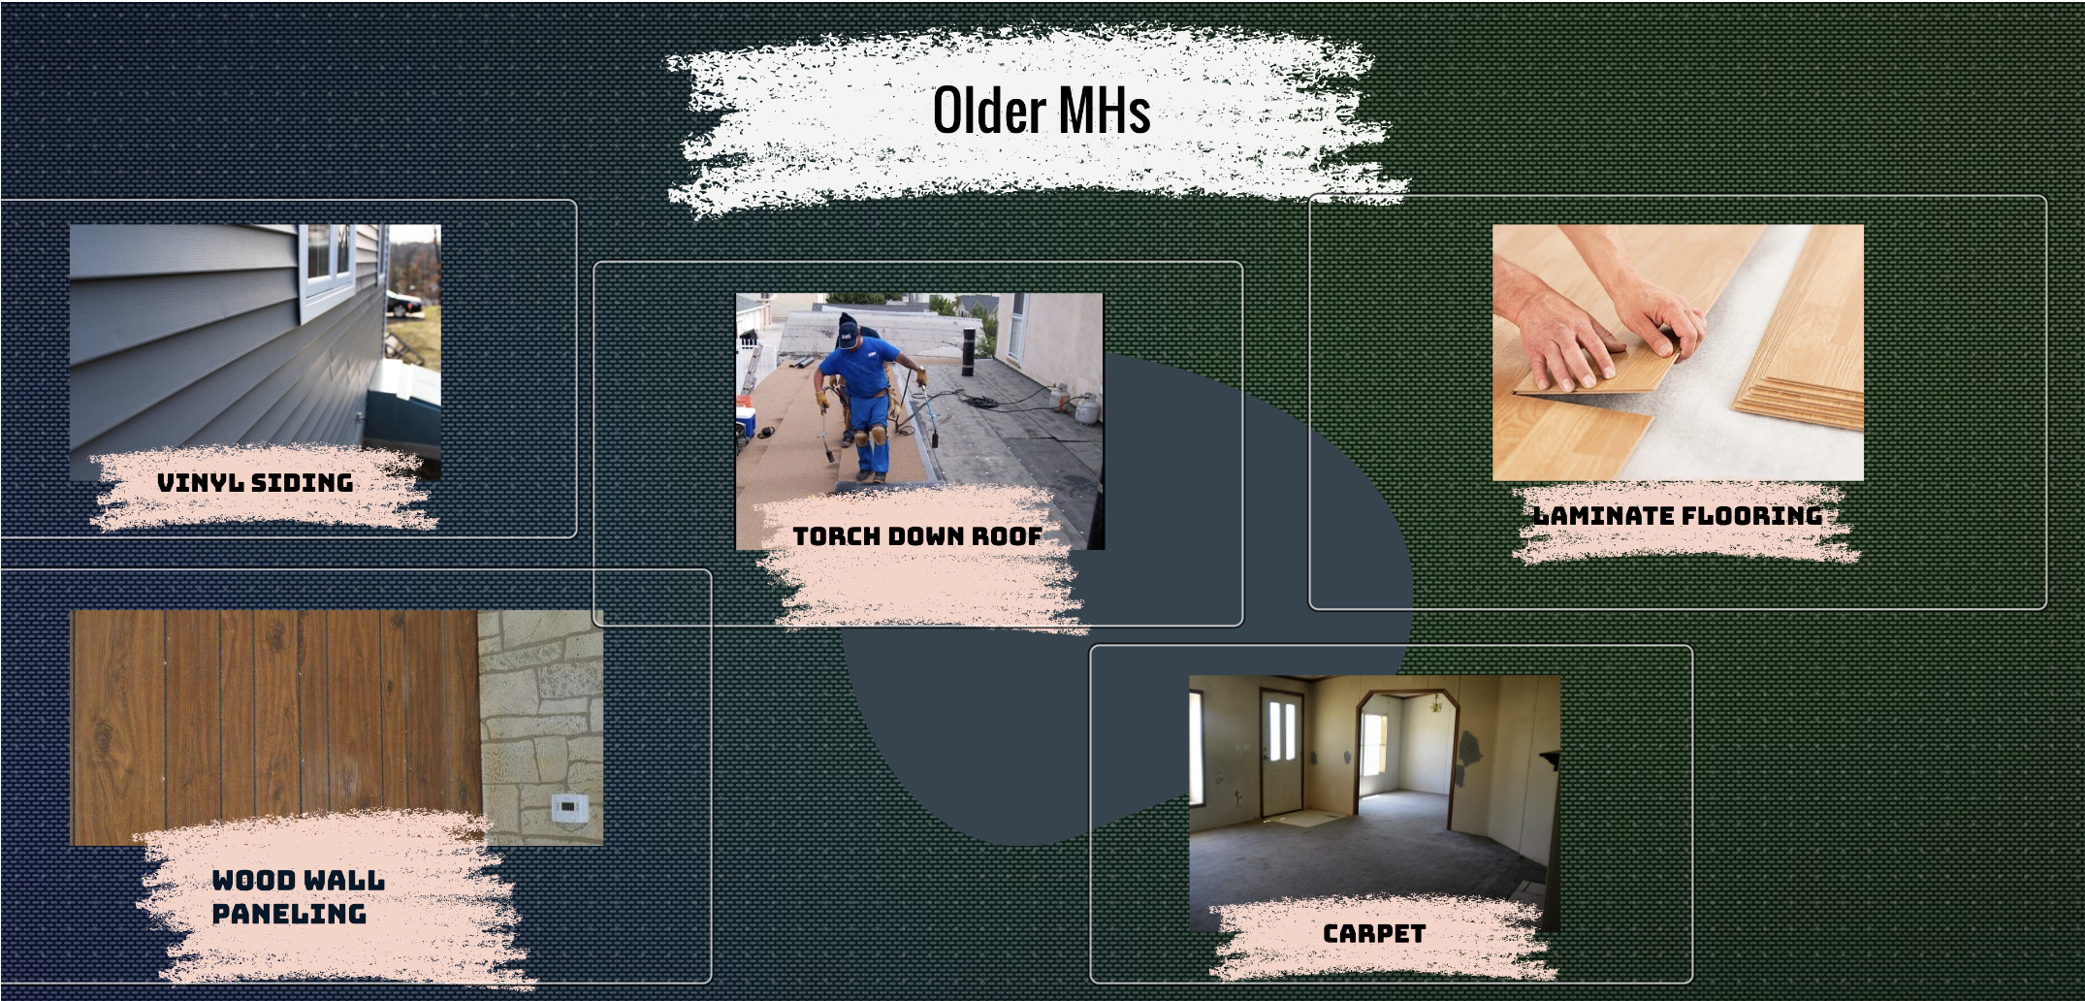
Conditions & Materials
MH are designed to be affordable, so builders don't spend the extra money to buy high quality materials
They are usually designed to last for about 50 years

Slide 13
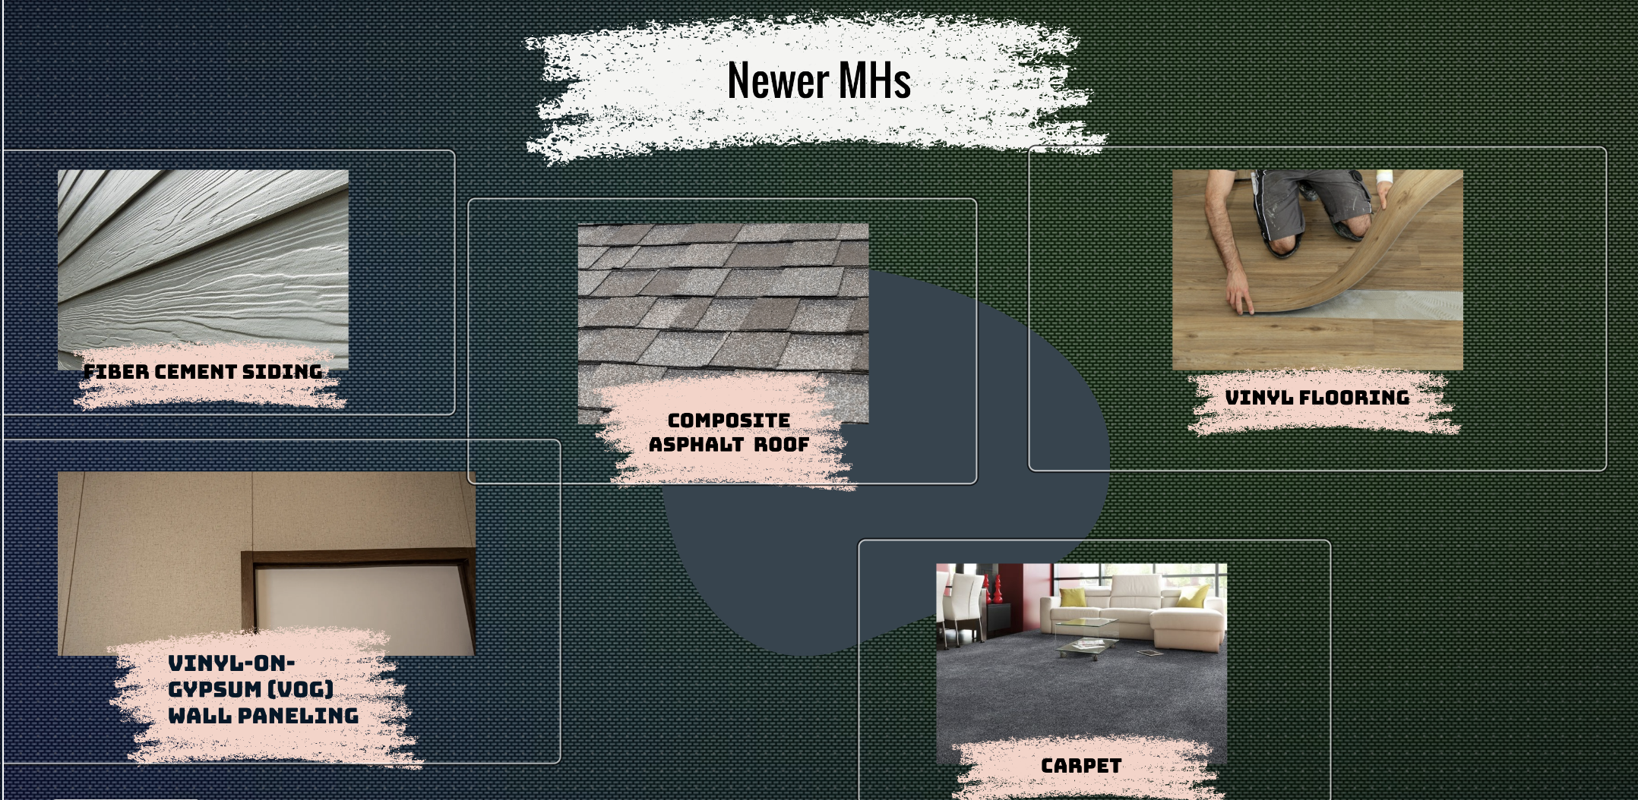
Conditions & Materials

Slide 14
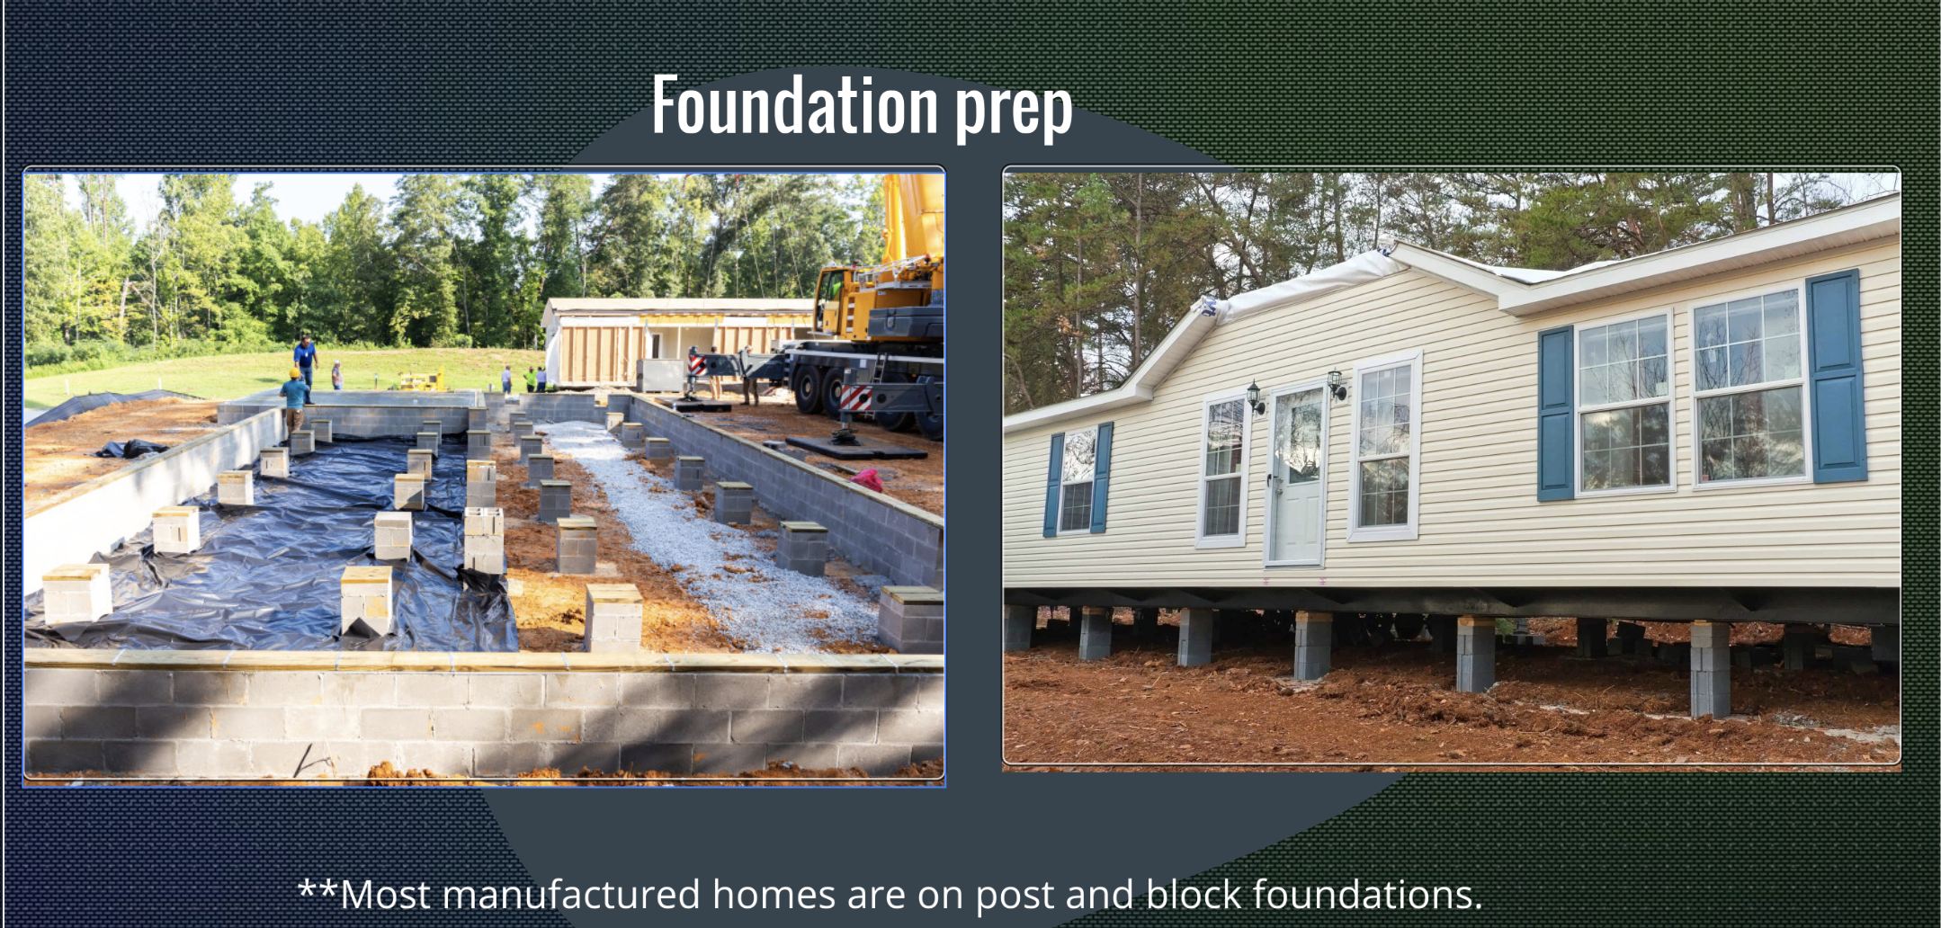
Conditions & Materials

Slide 15


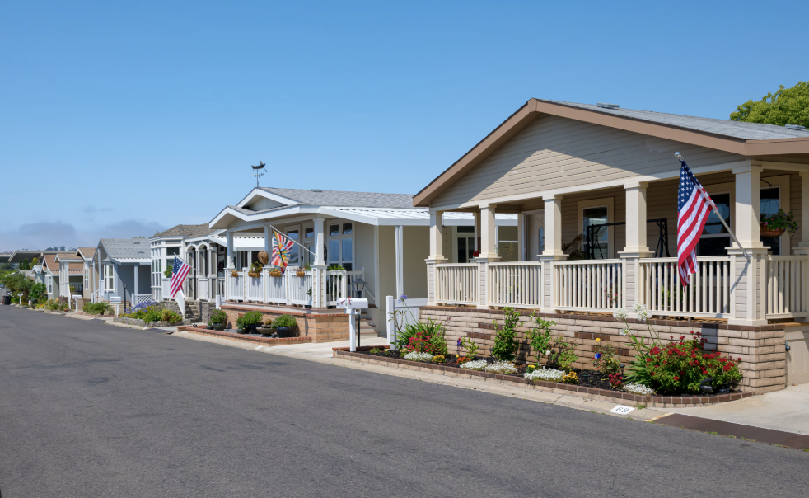
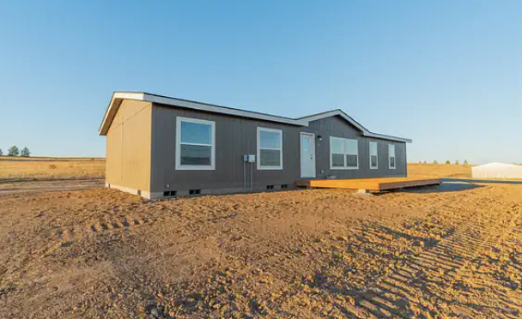
Rent VS Own
OWNED
Just like a regular single family residence, MH resides on private owned land
SPACE RENT
MH resides in a MH community where you own the home, but rent the land
Payment to HOA (usually under a $1,500/month) which then provides services such as ensuring utilities are working, common area maintenance/repairs, etc.

Slide 16
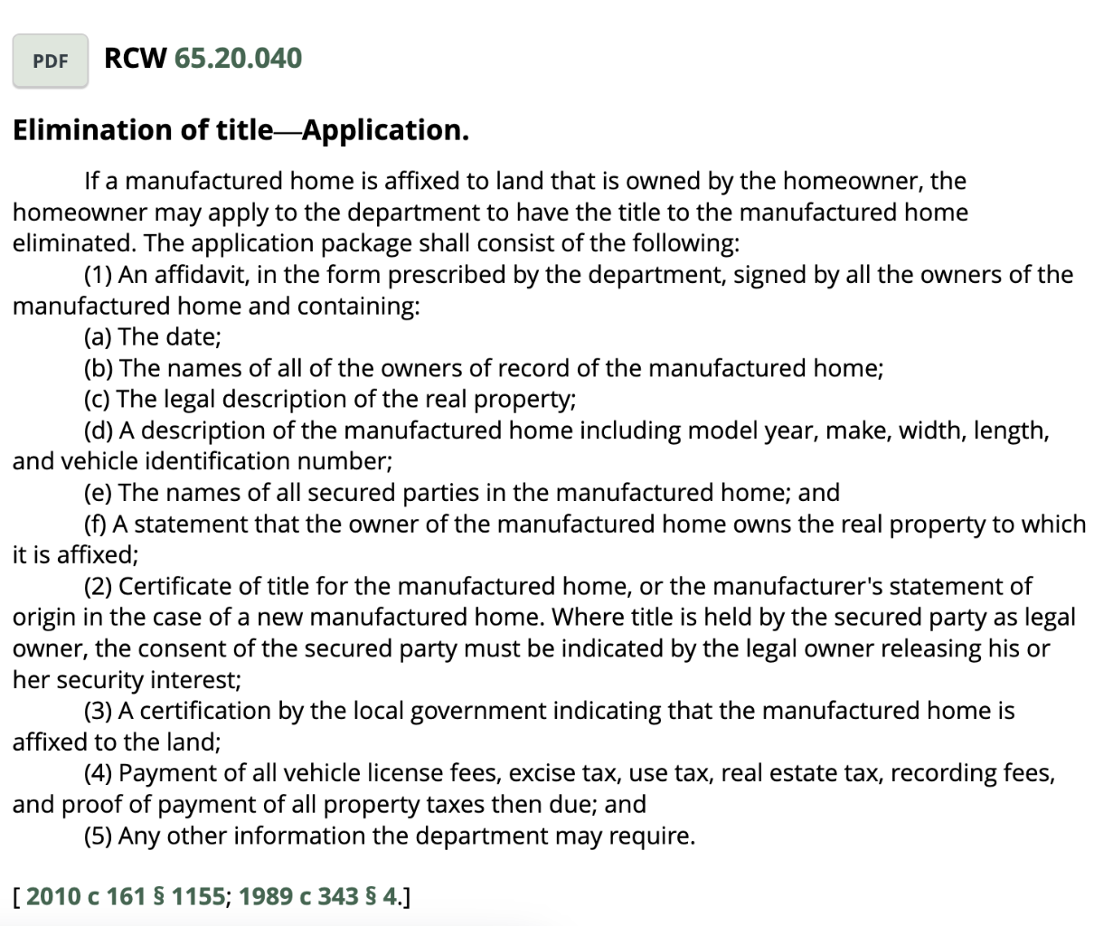
Title Elimination
Title elimination for a manufactured home is the process of legally converting its status from personal property (like a vehicle) to real property (like traditional real estate). This is often necessary for the home to be sold with the land it sits on or to qualify for traditional mortgages.
WHY?
Helps open up financing options
Often times a lender requirement
Removes personal property status for titling and lending

Slide 17

Lending Requirements for pre 1976
Two types of Lending when it comes to MH:
Chattel loan:
are loans for Mobil homes or movable property like machinery or vehicles. The “chattel” acts as collateral, just like a regular home loan.
Portfolio loan:
are loans that are kept “in-house” and not sold to secondary market
Be mindful that the type of MH (single-wide, double-wide, triple-wide), if it’s been moved more than once, whether title is eliminated or not, etc. will affect which lenders are able to give the loan

Slide 18

Lending Requirements for post 1976
If built post June 15th, 1976, there many lending options available.
Be mindful that the type of MH (single-wide, double-wide, triple-wide), if it’s been moved more than once, whether title is eliminated or not, etc. will affect which lenders are able to give the loan

Slide 19

Comping
When comping you mainly want to make sure these 4 categories are taken into consideration:
MH types (single, double, modular, etc)
Own vs Rent (HOA amount)
Pre-1976
Post-1976

