Slide 1



DR University
Zillow Calls!
November 2025
Presented by Sarah Wilhite

Slide 2
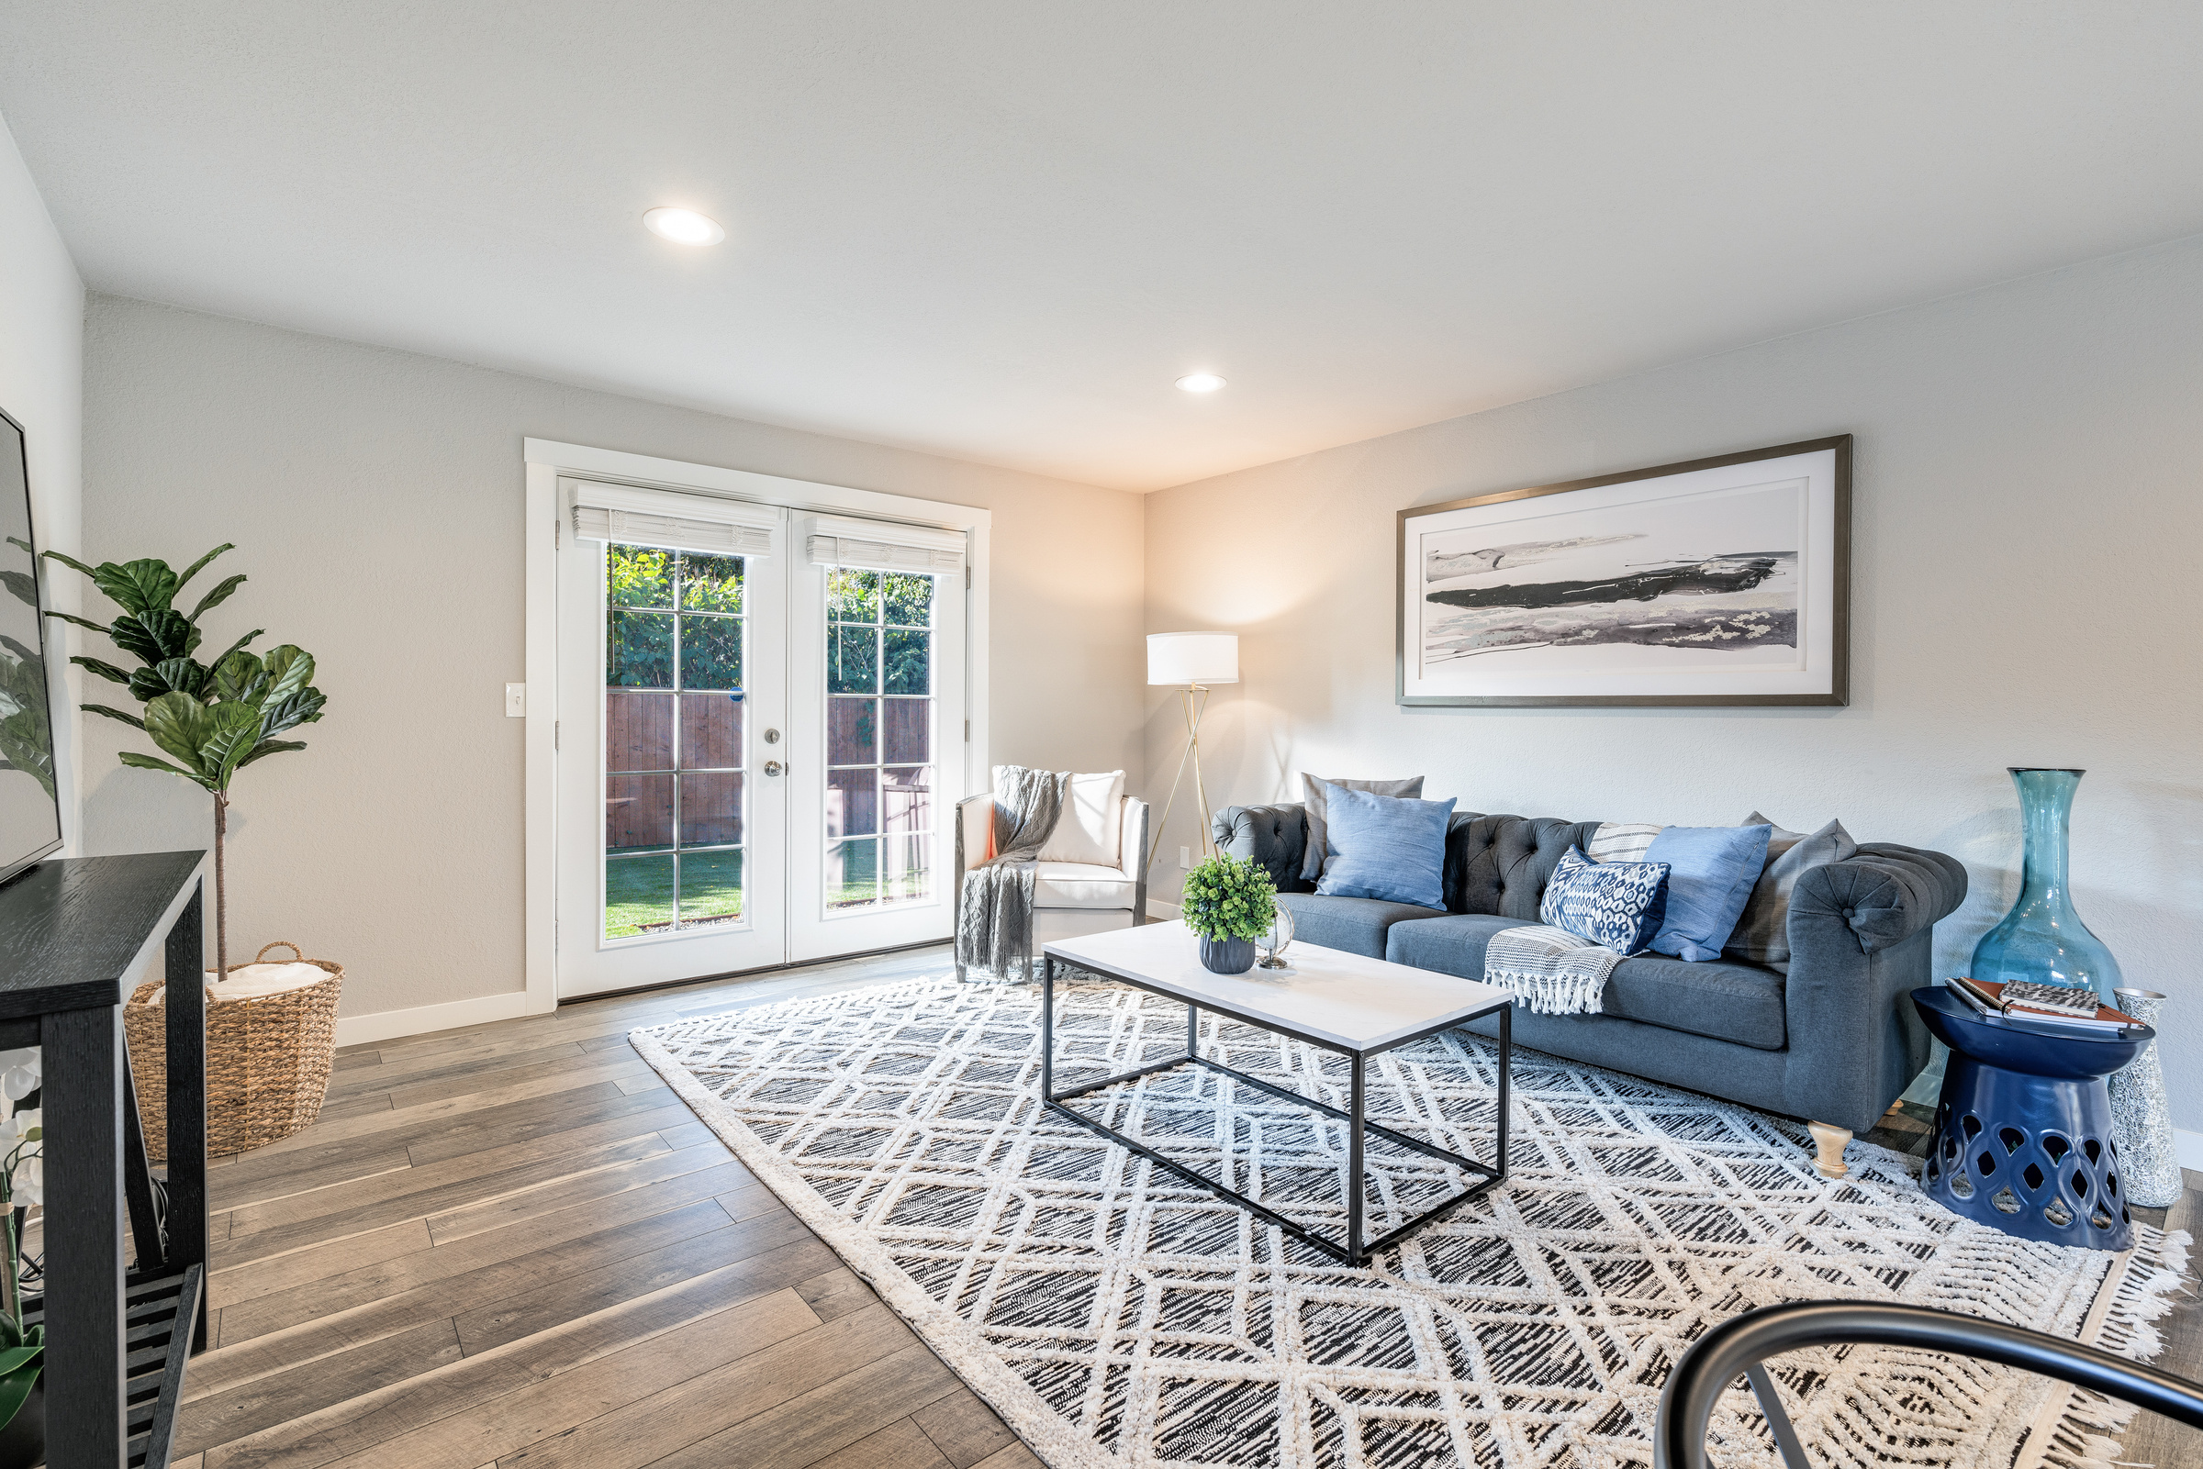
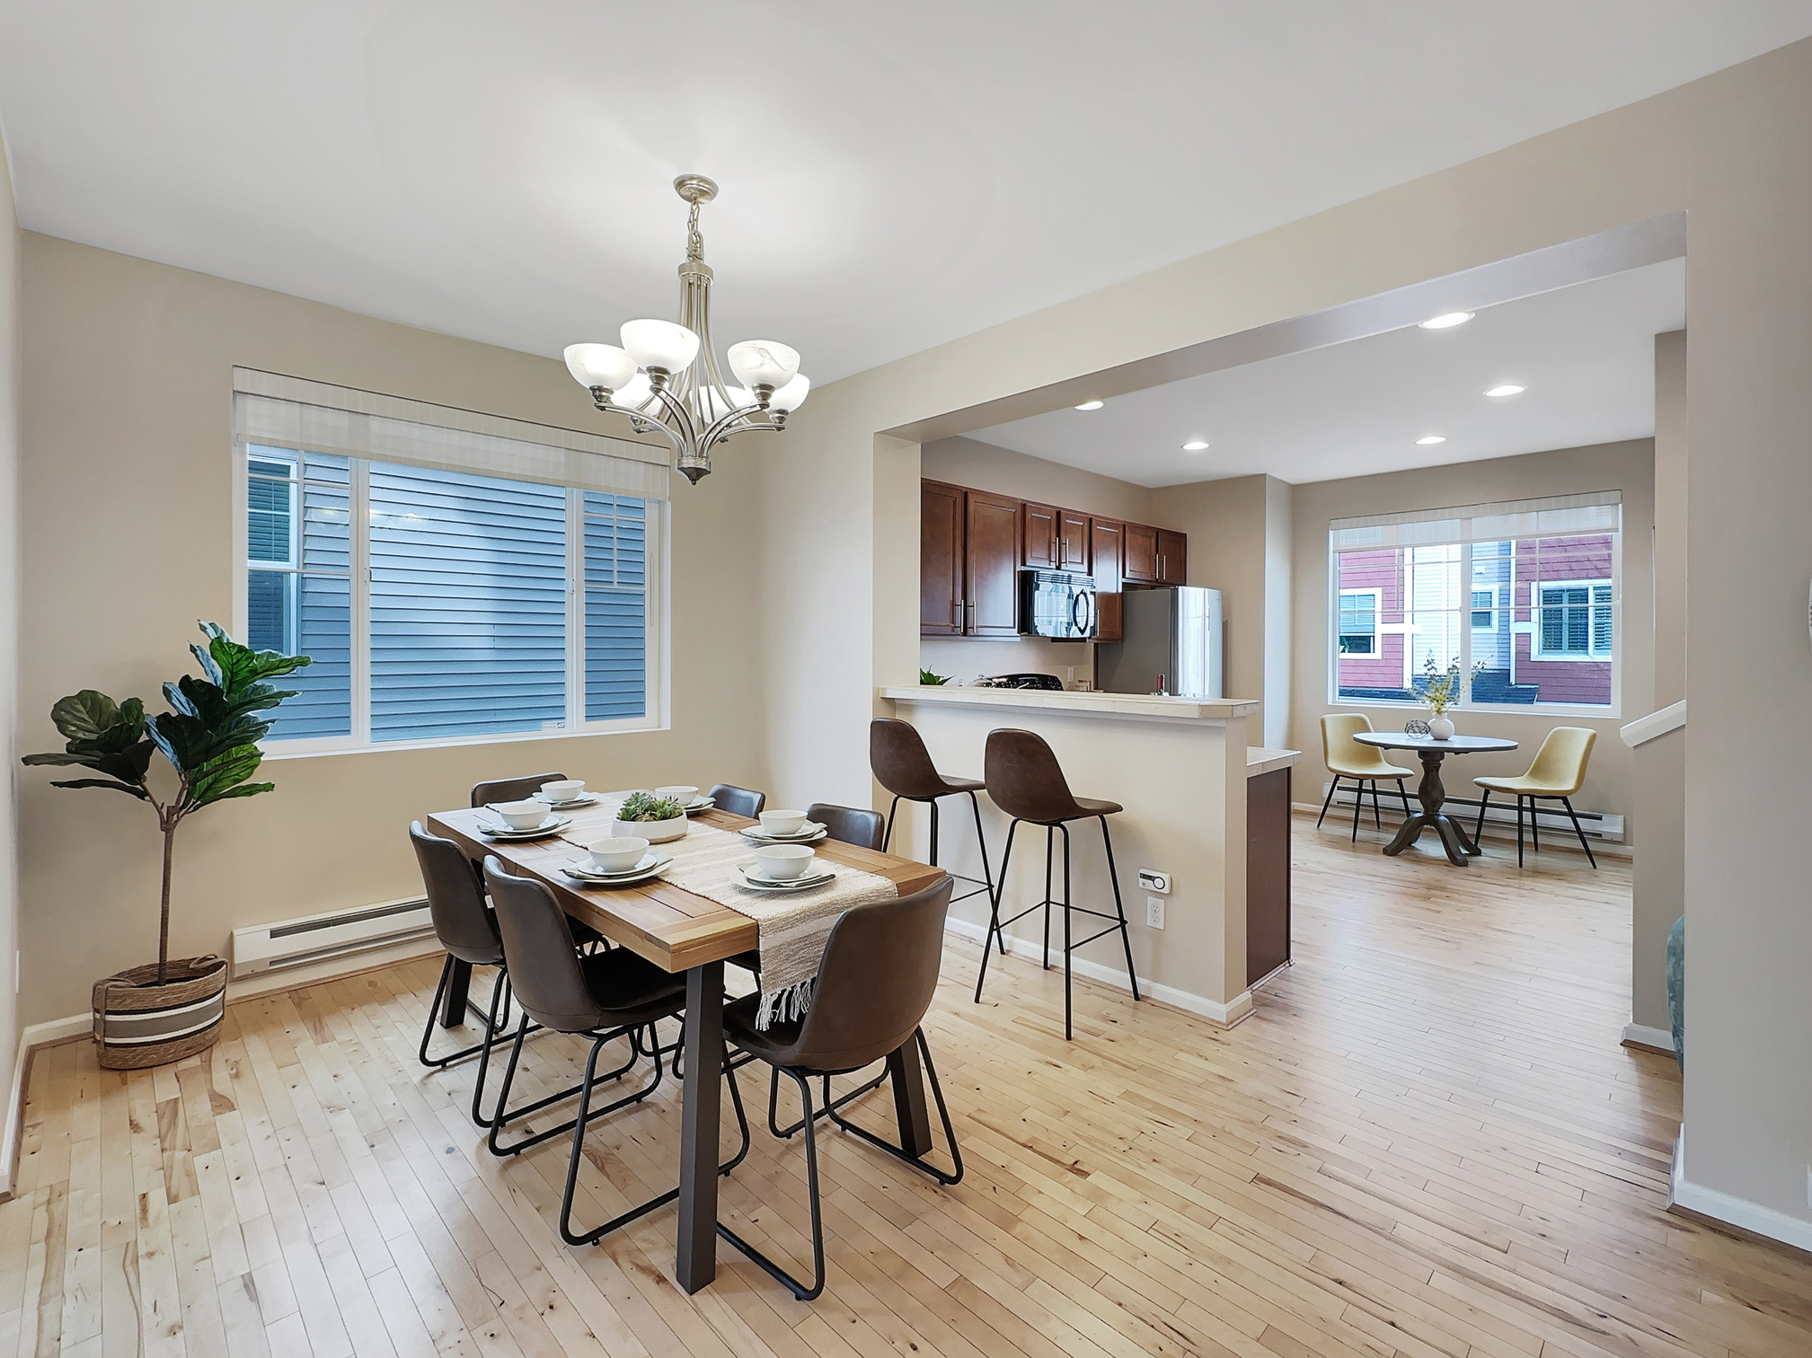


Agenda
Why Zillow Matters
Performance expectations – why this session is important
How buyers connect with us
ALM: your foundation
Common ALM Mistakes
4-Point System (when you don’t know the answer)
Bumps in the road
Handling curveball calls
How to end every Zillow Call
Real Time Tour (RTT) leads
Zillow Home Loans info

Slide 3

Why Zillow Matters
Zillow is THE top real estate lead funnel (200+ monthly visitors)
As a Zillow Preferred Partner, the better we perform in our Zillow metrics, the more leads you and the rest of our team will receive
Buyers contacting us are high-intern and actively searching
These aren’t cold calls – buyers typically respond within 5 minutes
Goal: Connect fast → Build trust → Set the appointment

Slide 4
Performance Expectations – why this session is important
To be a part of the Zillow Preferred team, you must meet and maintain all of the following criteria:
90% customer satisfaction score (CSAT) from Zillow
50% pickup rate on all Zillow calls
7% individual conversion rate after 12 months on the team
Attend all required Zillow meetings & in-person at least 2 times per month for our weekly Wednesday meetings
Retain an updated pipeline in FUB at all times
Have this be your full time job!

Slide 5
How Buyers Connect With Us
The customer has a couple options on the Zillow platform - they can request to speak to an agent or request to see a property. They can also dial a broker directly.
What happens when they click on “contact agent” button?
Zillow texts the consumer asking if they are ready to talk to an agent. They have to respond affirmatively within 5 minutes to be direct connected to us.
What happens when they click on “take a tour” button?
Same as above, just before they book a time and date for the showing.
Can they contact me any other way?
Yes, they can directly contact us from the agents profile page. In which case, you will answer a second Zillow number and the caller will be on the other end. There is no middle man, property identified, or introduction.
“What If I’m Driving or Busy When Zillow Calls?”
We call this shower anxiety—Zillow always seems to call at the worst times. Don’t worry. As you get more confident, you’ll realize:
• You rarely need to have the listing pulled up to set an appointment.
• It’s OK to answer with a little background noise—real life happens!
• Take the call when it’s safe and reasonable. It’s better to answer imperfectly than miss the opportunity.
TAKE ACTION: To avoid missing calls, save these Zillow numbers in your phone:
Main Lead Number: 206-539-0456
Direct Call: 425-657-5142

Slide 6
Mastering the First Call - ALM
ALM is the foundation of every successful Zillow Flex call:
A – Appointment
“Hi, this is [Your Name] with Designed Realty. I saw you wanted to see the rambler on Main Street at 1 PM today. Does that still work?”
L – Location
“Are there any other homes you’d like to see while we’re out?”
M – Motivation
“What was it about this one that caught your eye?”

Slide 7
Mastering the First Call - ALM
The “Perfect ALM Call Breakdown:
ALM Point | Example Line
A – Appointment | “When would you like to go take a look?”
L – Location | “Are there any others you’d want to check out while we’re out?
M – Motivation | “What about this home that caught your eye?”
Close | “Great! I’ll text you my info and see you at 3pm.”

Slide 8
Mastering the First Call - ALM
Common mistakes and how to fix:
Mistake | What Happens | Fix
Skipping Location | You miss the change to schedule multiple tours | Always ask if they want to see anything else
Jumping to financing | Breaks trust and makes it feel like a sales pitch | Stick to the tour first, then let conversation evolve
No motivation questions | You lose insight into buyer priorities | Ask ‘what caught your eye?’ or ‘what made this one stand out?’
Forgetting to confirm | No follow-up text = missed appointment | Always end with: ‘I’ll send you a quick text with my info’

Slide 9
Master the First Call - ALM
Why does ALM Matter?
80% of Zillow buyers who convert into transactions start with a call where ALM was used.
It keeps the conversation productive, on-track, and focused on your goal: getting face-to-face.
How ALM is tracked
Zillow uses AI call-scoring to evaluate whether all three ALM elements were hit.
These are used in:
Coaching feedback
Conversion metric validation
Internal reviews of agent performance

Slide 10
4-Point System
“What if I don’t know the answer to a question”
Don’t worry! No agent knows everything.
We have a 4 point system, that works every time to keep the conversation going and you showcasing your skill.
Admit confidently you don’t know
Confirm you will see what you can find out
Showcase your knowledge!
End with a question - ALWAYS
“I don’t know”
“I’ll see what I can find”, or
“I’ll track that down!”
“In my experience…”
Example: “Have you dealt with roof issues in the past?”

Slide 11
Bumps in the road…
Occasionally a caller will take you off your ALM roadmap with questions of their own. The goal is to use the practices below to get back on track:
“Are you the listing agent?”
“No – I am a licensed broker. Did you have specific questions?”
“I’m already working with an agent”
“Well, you have me on the phone and I can get the showing lined up.”
“Is there an open house this weekend?”
“It looks like someone posted there will be, but in my experience it’s a crap shoot if someone is going to be there. I can get you in though, when works?”
What are other examples you’ve encountered?

Slide 12
Curveball Calls
When the caller asks you a question, use your 4-point system when you don't have the answer, ending with a question from below. Continue asking questions until you feel you have enough information to start working with this caller.
We have a system in place to handle all types of calls that are outside of just simply buying and selling an existing home:
Land Deals
New Builds
Tear Downs
Clown Properties
Out-of-State

Slide 13
Curveball Calls
When the caller asks you a question, use your 4-point system when you don't have the answer, ending with a question from below. Continue asking questions until you feel you have enough information to start working with this caller.
Let’s start with land deals as an example. Many callers inquire about land – but have no fear, we have a roadmap for that too!
Intro: "I see you are looking at this piece of land in ______. Do you want to go take a look, or do you have some specific questions for me?"
When the caller asks you a question, use your 4-point system when you don't have the answer, ending with a question from below. Continue asking questions until you feel you have enough information to start working with this caller.
Dive into the 5 W's:
Who: Have they built before or owned before?
What: What do they want to do with the property?
Where: Is this the only area?
When: When are they wanting to make a move?
Why: Why do they want to build or have a recreational property?
Other questions to consider asking:
How familiar are they with the area?
How far down the rabbit hole have they gone?
Are you cash or looking at financing?

Slide 14
Ending any Zillow Call!
your 4-point system when you don't have the answer, ending with a question from below. Continue asking questions until you feel you have enough information to start working with this caller.
Wrap up!
You now will give them 2 options for next steps:
Meet at the property or,
Schedule a meeting (via zoom or in person) to review the information you need to go find
Example: “Ok, so I'm going to gather up that information, and I want to take a peak at a couple other properties too. Do you want to get boots on the ground and meet out at this property and walk and talk? Or we can pop onto zoom and go over this stuff."
They may say no, and that's ok! Dive into AVS:
AVAILABLE: "I am available whenever you are ready.“
VALUE: "I'll dig up that information you requested and get that sent over to you (or call you back with it).""
SCHEDULING: "If you see anything else on Zillow, feel free to click the same button and it will come straight to me, land or house. I’ll also text you my contact information directly.”
END: “Is there anything else I can help you with at this moment?”

Slide 15
Real Time Tour (RTT) Leads
your 4-point system when you don't have the answer, ending with a question from below. Continue asking questions until you feel you have enough information to start working with this caller.
Connect with high-intent customers, get to your first face-to-face appointment faster and save time with ShowingTime-integrated booking.
Answering the Real Time Tour call
Caller ID on your device will show - “Real Time Tour” for all RTT leads.
This allows agents to review the tour request without having to speak to a buyer in real time.
If you don’t see the Real-Time Touring Caller ID on your mobile device when you receive a Real-Time Tour lead, update your Premier Agent App.
You have 5 Minutes to commit or pass Reminder (no live customer on the line).
Only accept the tour if you can commit to fulfilling one of the times requested. Otherwise, pass it on to the team.
The Golden Text
Within 30 minutes of committing to the appointment then text to confirm using the Golden Text
For example:
“Hey it’s Kevin with Designed Realty! Zillow sent me your info, and I’m excited to give you a tour of 123 Main Street in Snohomish at 3:00 PM tomorrow. Just to confirm, does this time still work for you?”
Key elements of the Golden Text include:
Stating your name and brokerage
Reminding the buyer that Zillow connected you
Confirming the tour location and time.
Note: Do not ask for pre-approval information in the first communication(s), unless the specific listing requirements in Showingtime require/ask for it.
If necessary, you can call, but do so after sending the Golden Text

Slide 16
Real Time Tour (RTT) – managing the appointment
your 4-point system when you don't have the answer, ending with a question from below. Continue asking questions until you feel you have enough information to start working with this caller.
Real-Time Tours should be managed directly in the Premier Agent App. Communicate any changes to the appointment with the buyer.
Once appointment has been scheduled, then progress the deal stage to 1st Appt Scheduled in Follow-Up Boss!
Buyer Communications from Zillow
Agents will be cc’d on all email communications that are sent to the buyer once the tour is accepted.
After they submit their request (and before its been accepted by an agent)
Tour Details: Property Address & Requested Times.
Note that you are looking for a Buyer’s Agent to take them on a tour.
As soon as an agent has accepted the lead
Tour Details: Property Address & Selected Time.
Agent Details: Your name, phone number, email, and a link to your Agent Profile on Zillow.
Note to reach out to you directly in case they need to cancel or reschedule.
Tour day reminders
Zillow sends the buyer a text reminder at 24 hours and 2 hours prior to the confirmed tour time.
If the tour is rescheduled
Tour Details: Property Address & Updated Time.
Agent Details: Your name, phone number, email, and a link to your Agent Profile on Zillow.
Note to reach out to you directly in case they need to cancel or reschedule.
If the tour is canceled
Tour Details: Property Address
Agent Details: Your name, phone number, email, and a link to your Agent Profile on Zillow.
Note that you will contact them with additional details.
If the initial tour request fails
Tour Details: Property Address & Requested Times
Agent Details: Your name, phone number, email, and a link to your Premier Agent Profile on Zillow.
Note that we weren’t able to book the tour yet, but that you will be in touch with additional details.

Slide 17
Real Time Tour (RTT) – no confirmation
your 4-point system when you don't have the answer, ending with a question from below. Continue asking questions until you feel you have enough information to start working with this caller.
What do I do if a RTT lead does not confirm with me?
If RTT doesn't confirm after multiple attempts and reach outs you can let them know you are canceling.
Don't be shy about confirming. Multiple calls and texts is okay if unanswered, when initially trying to confirm give them time to respond but closer you get to showing you can ramp it up.
PLEASE NOTE: THIS METHOD DOES NOT APPLY TO ANY OTHER LEAD

Slide 18
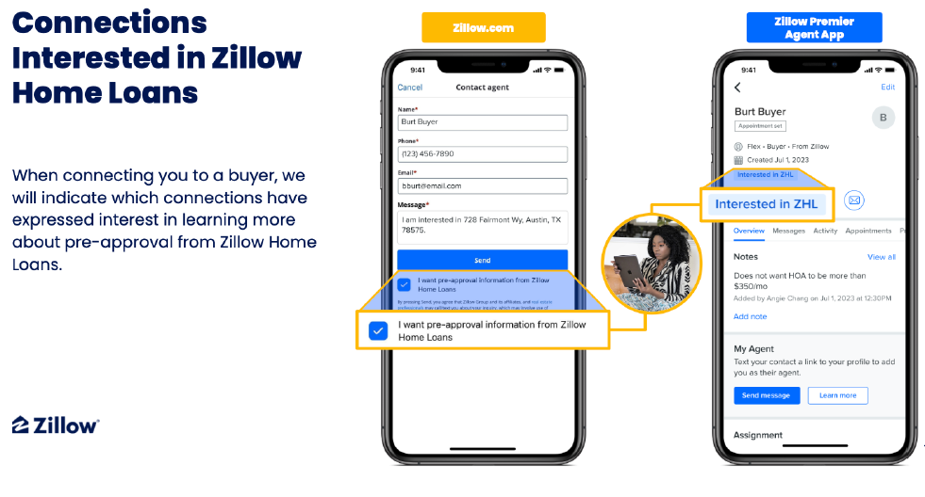
Zillow Home Loans – connections interested
your 4-point system when you don't have the answer, ending with a question from below. Continue asking questions until you feel you have enough information to start working with this caller.

Slide 19
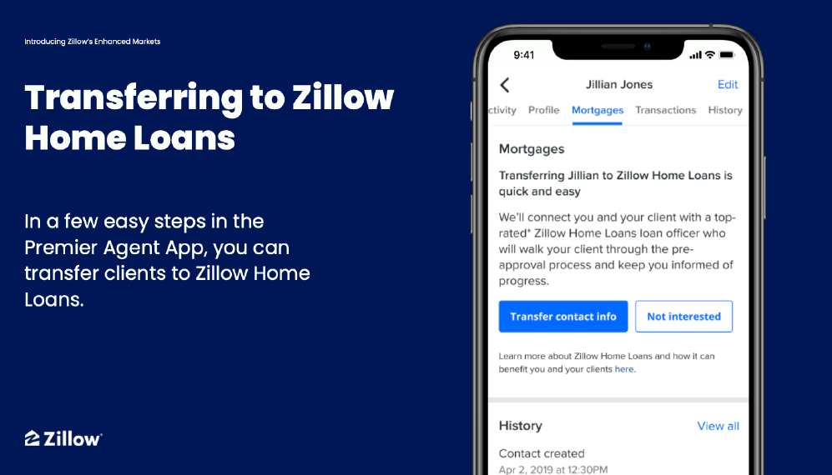
Zillow Home Loans – transferring to ZHL
your 4-point system when you don't have the answer, ending with a question from below. Continue asking questions until you feel you have enough information to start working with this caller.

Slide 20
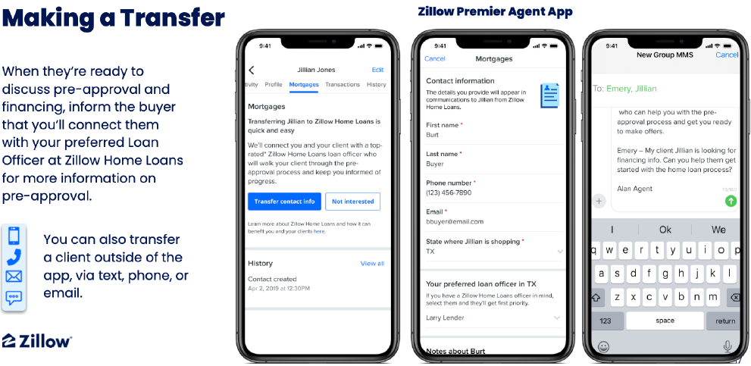
Zillow Home Loans – transferring to ZHL
your 4-point system when you don't have the answer, ending with a question from below. Continue asking questions until you feel you have enough information to start working with this caller.

Slide 21
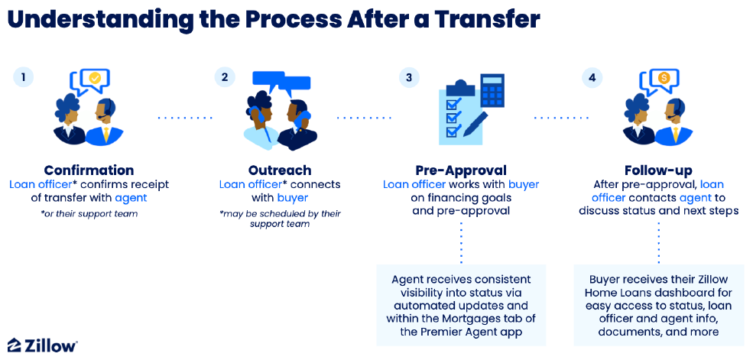
Zillow Home Loans – what happens next?
your 4-point system when you don't have the answer, ending with a question from below. Continue asking questions until you feel you have enough information to start working with this caller.

